Slide 1


"A Study in order to Forecast the future trends for Precipitation to measure Rainfall, Snow and Heat patterns in NEWS Regions of U.S.A." : A Time Series Approach
By
Deepan Ilangkamban Ramesh

Slide 2
CONTENT
Importing necessary libraries
News – u.s.a.
Geospatial analysis
Tableau visualization
summary

Slide 3
Importing Necessary Libraries
Import Pandas, NumPy for Data frame and numerical operations
Import Datetime for parsing date
Import stat models for ADF statistics
Import ARIMA for stationarity
Import geopandas for graphical visualization

Slide 4

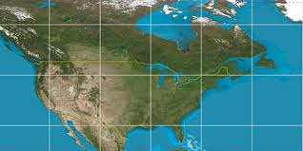
VIRGINIA

Slide 5

Hypothesis
H0 : Time Series is Stationary
H1 : Time Series is Non – Stationary

Slide 6
Augmented Dickey Fuller Statistics
ADF Statistics:
-5.272537
p-value: 0.000006
Critical Values:
1%: -3.670
5%: -2.964
10%: -2.621

Slide 7
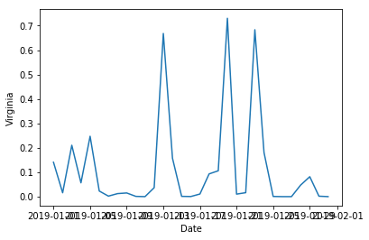
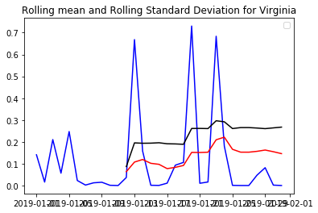
VIRGINIA
STATIONARITY
Rolling Mean and Standard Deviation are stationary for Virginia.
ADF Statistics is < Critical Value
The alternate hypothesis is rejected and hence the time series is stationary.

Slide 8

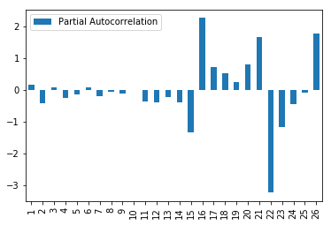
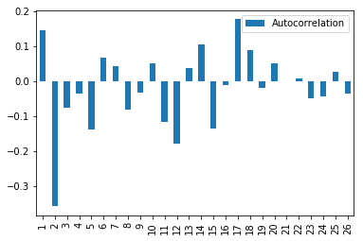
ARIMA MODEL
BOX JENKINS MODELING
ACF AND PACF

Slide 9
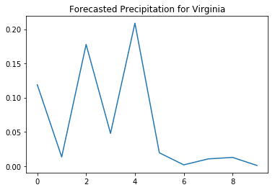
VIRGINIA PREDICTED TRENDS FOR 10 YEARS

Slide 10
PIPELINE MODEL FOR CALIFORNIA, NORTH DAKODA AND TEXAS

Slide 11
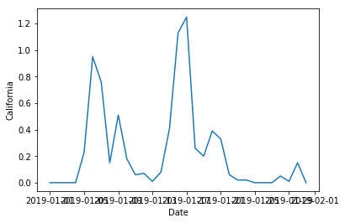
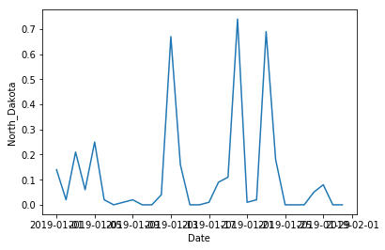
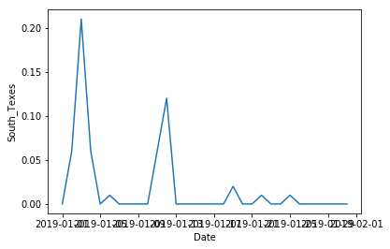
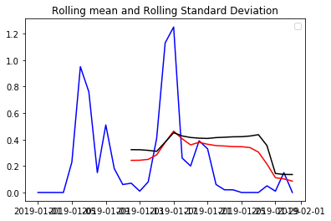
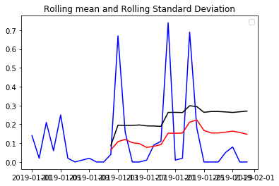
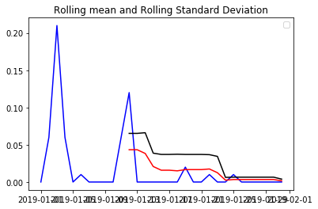
PIPELINE MODEL FOR CALIFORNIA, NORTH DAKOTA AND TEXAS
CALIFORNIA
NORTH DAKOTA
TEXAS

Slide 12
ADF STATISTICS FOR CALIFORNIA, NORTH DAKOTA AND TEXAS
CALIFORNIA
NORTH DAKOTA
TEXAS
ADF Statistics: -3.322119
p-value: 0.013918
Critical Values:
1%: -3.679
5%: -2.968
10%: -2.623
ADF Statistics: -5.243068
p-value: 0.000007
Critical Values:
1%: -3.670
5%: -2.964
10%: -2.621
ADF Statistics: -1.054944
p-value: 0.732701
Critical Values:
1%: -3.770
5%: -3.005
10%: -2.643
ADF Statistics is < Critical Value
The alternate hypothesis is rejected and hence the time series is stationary.
ADF Statistics is < Critical Value
The alternate hypothesis is rejected and hence the time series is stationary.
ADF Statistics is > Critical Value
The null hypothesis is rejected and hence the time series is non - stationary.

Slide 13
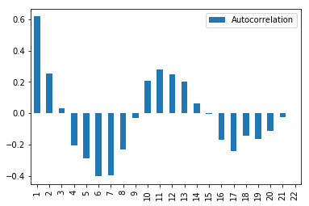
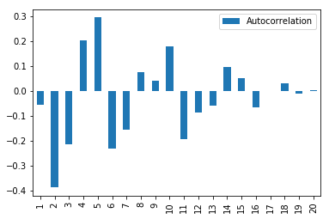
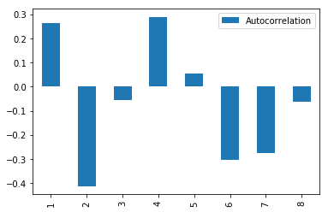
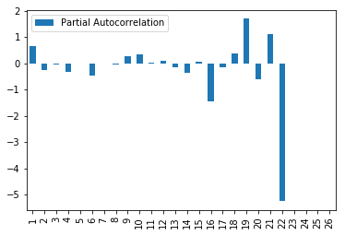
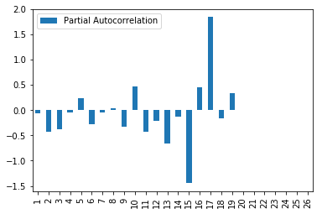
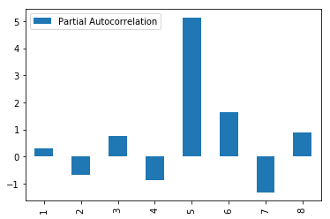
ARIMA MODEL FOR CALIFORNIA, NORTH DAKOTA AND TEXAS
CALIFORNIA
NORTH DAKOTA
TEXAS

Slide 14
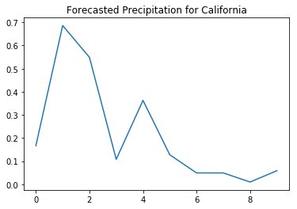
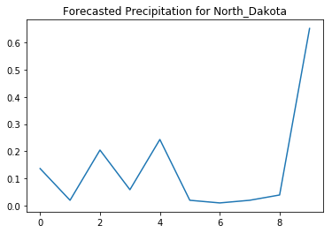
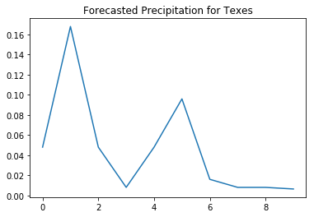
FORECASTED TRENDS FOR CALIFORNIA, NORTH DAKOTA AND TEXAS
CALIFORNIA
NORTH DAKOTA
TEXAS

Slide 15
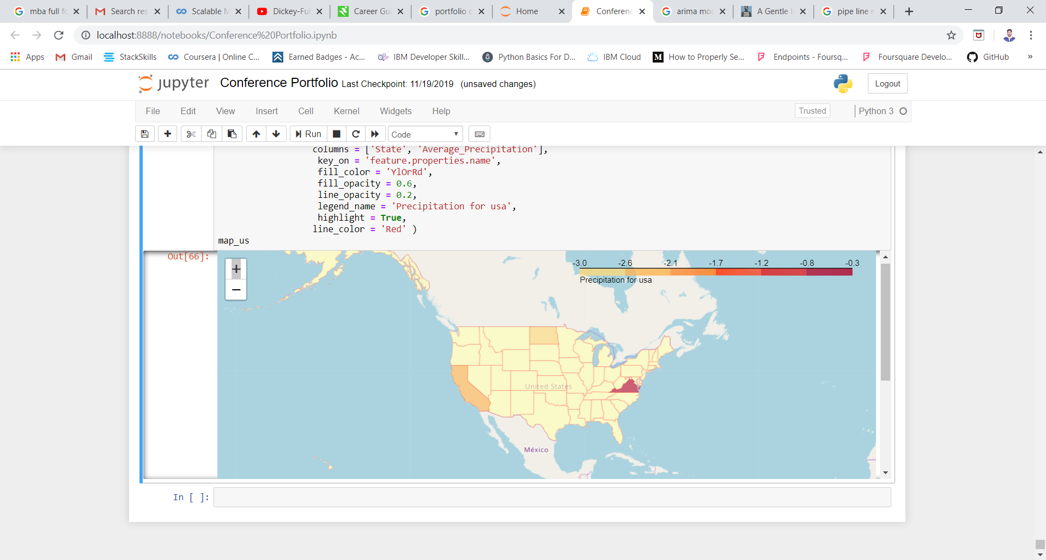
GEOSPATIAL ANALYSIS

Slide 16
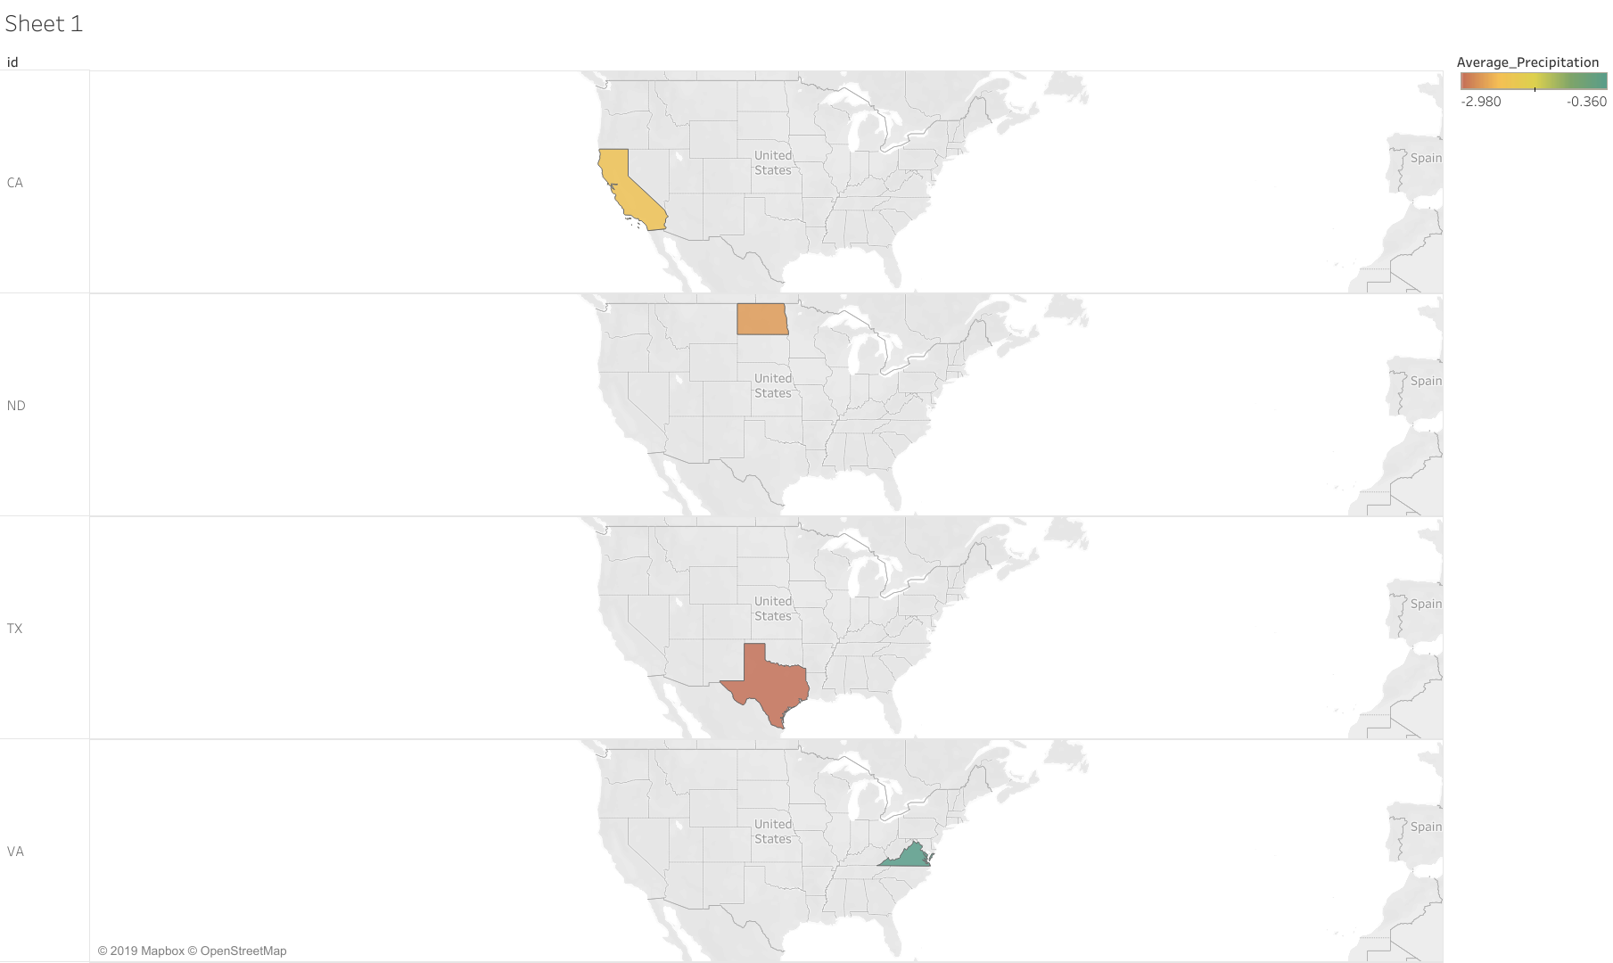
TABLEAU O/P

Slide 17
SUMMARY
Precipitation change
Changing Rain and Snow patterns when temperature increases air becomes warmer, more moisture evaporates from land and water in to the atmosphere. More moisture in the air result in more rain and snow.
What is Happening Now?
World is getting more precipitation now than in 100 years ago. Especially us is experiencing 6% overall on comparing it with worldwide of 2%

Slide 18

Major effects on changing rain and snow patterns on people and the environment
Agriculture
Water supplies
Energy
Plants, animals and ecosystems

Slide 19

Agriculture
Northern parts of U.S. have generally cool temperatures, warmer weather will helps certain crops to grow. Southern temperature is already hot more heat could hurt the crops. As from the visuals the trends for Agriculture is favourable in Virginia for future ten years.

Slide 20
Water supplies
Already water scarcity is inline day by day climate change can make this worse.
Rising temperatures
Changing Precipitation Patterns
Will affects the amount of water in lakes, rivers, streams as well as water steeps into ground to replenish ground water.

Slide 21

Plants, animals and ecosystems
Most of the plants, animals live with very specific conditions, such as temperature and rainfall patterns, changes will affects there regular habitat and ecosystems. From the visualization there is the clear fluctuations in precipitation which means the snow or rain pattern may changes in future will make the animals to migrate to one place to other most earlier or very later.

Slide 22

Thank you

